Slide 1
공개 소프트웨어 프로젝트
Team 10

Slide 2
Connect 5,6 AI
Build a platform for Programs to Compete with each other
Develop a Reinforcement Learning Based Connect6 Program
Rule-Based Model
Use Open Source SW
Reinforcement Learning Model
Reinforcement Learning Concepts
Zero-based

Slide 3
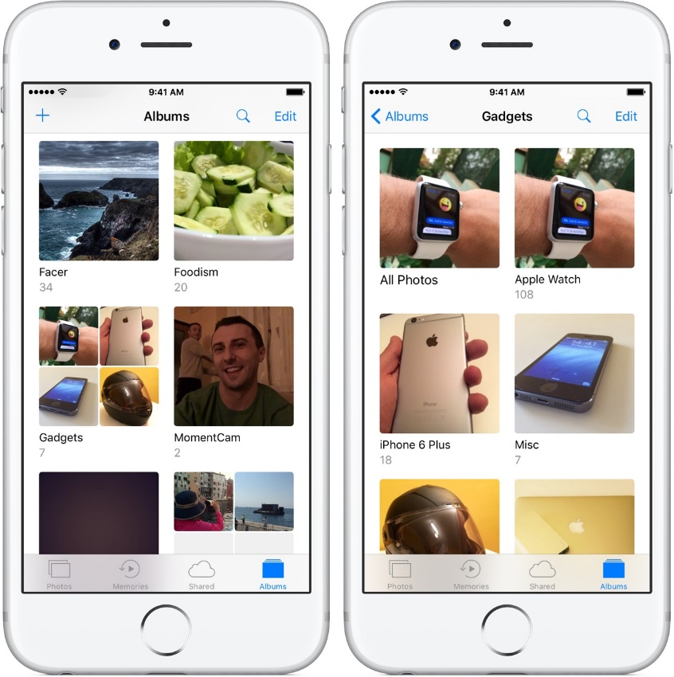
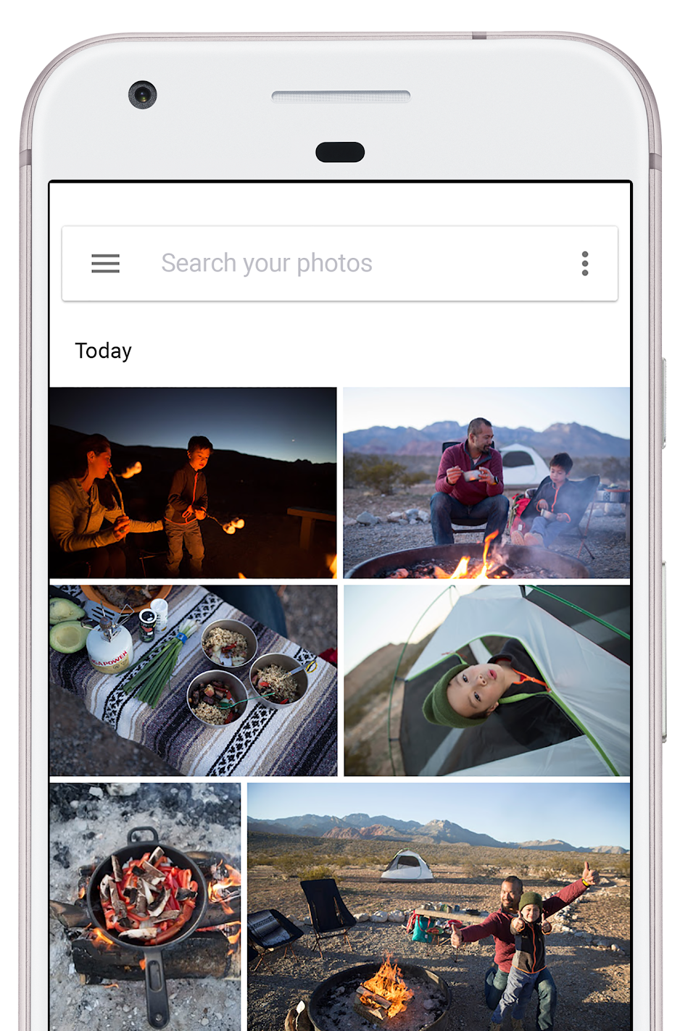
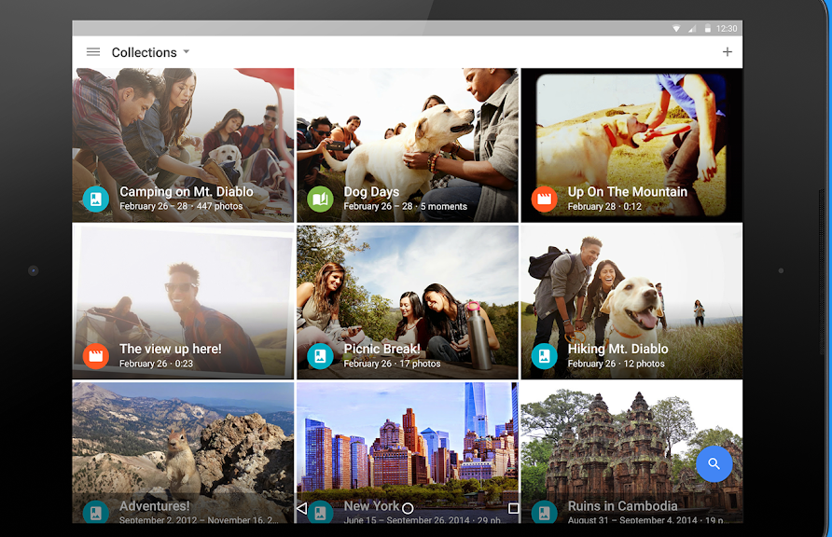
Smart Album with Cloud
IOS
Google Photos(App)

Slide 4
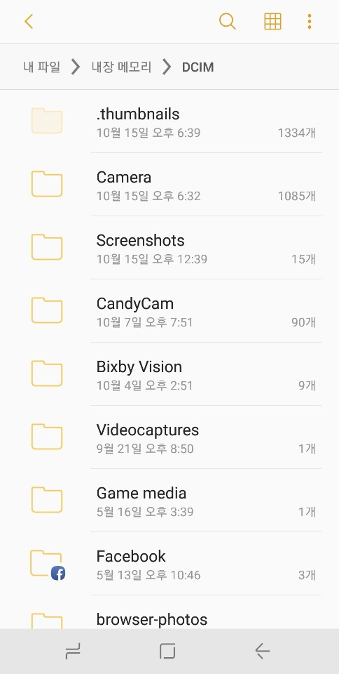




Smart Album with Cloud

Slide 5








Smart Album with Cloud
Share
Download

Slide 6
Smart Album with Cloud
Options
Arrange by Location :
Local, City, Country
Arrange by Time :
By Day, By Time Distribution
Automated Upload Time
Additional Features
Facial Recognition Classification
Background Recognition Classification
Etc

Slide 7
Open API
Google API Terms of Service
https://developers.google.com/terms/
Google Developer Content License
Android Studio
Google App Store
Apache 2.0 license
http://www.apache.org/licenses/LICENSE-2.0

Slide 8
Thank You
Team 10

